Slide 1
Streamlit (Multipage App , sharing app and converting to exe)
CSC221(Advanced Python)

Slide 2
Content
Creating a multipage streamlit app, not using sidebar
Sharing streamlit app (using Streamlit Community Cloud and GitHub)
Converting Streamlit App to EXE file (Console based)
Converting Streamlit App to EXE file (Window Based)

Slide 3
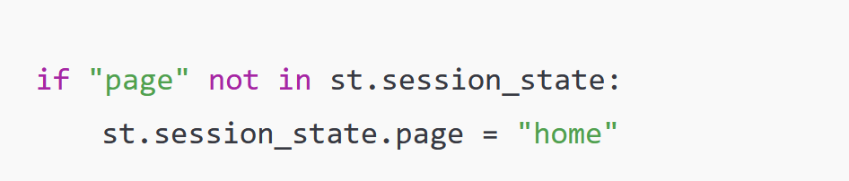
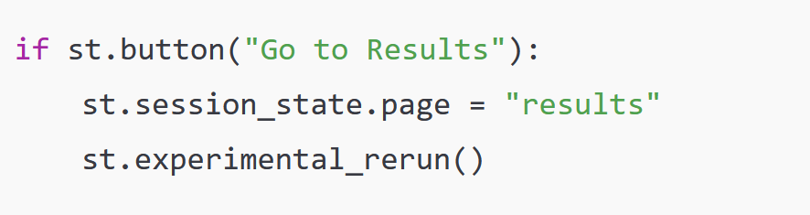
1 Creating a multipage streamlit app, not using sidebar
1. Use st.session_state for Navigation
Create a "page" key in st.session_state to track which page should be shown.
Update this key when a button is clicked to simulate page navigation.
2. Use st.experimental_rerun() for quick navigation between pages
(without st.experimental_rerun() the program won’t change until the next interaction).

Slide 4
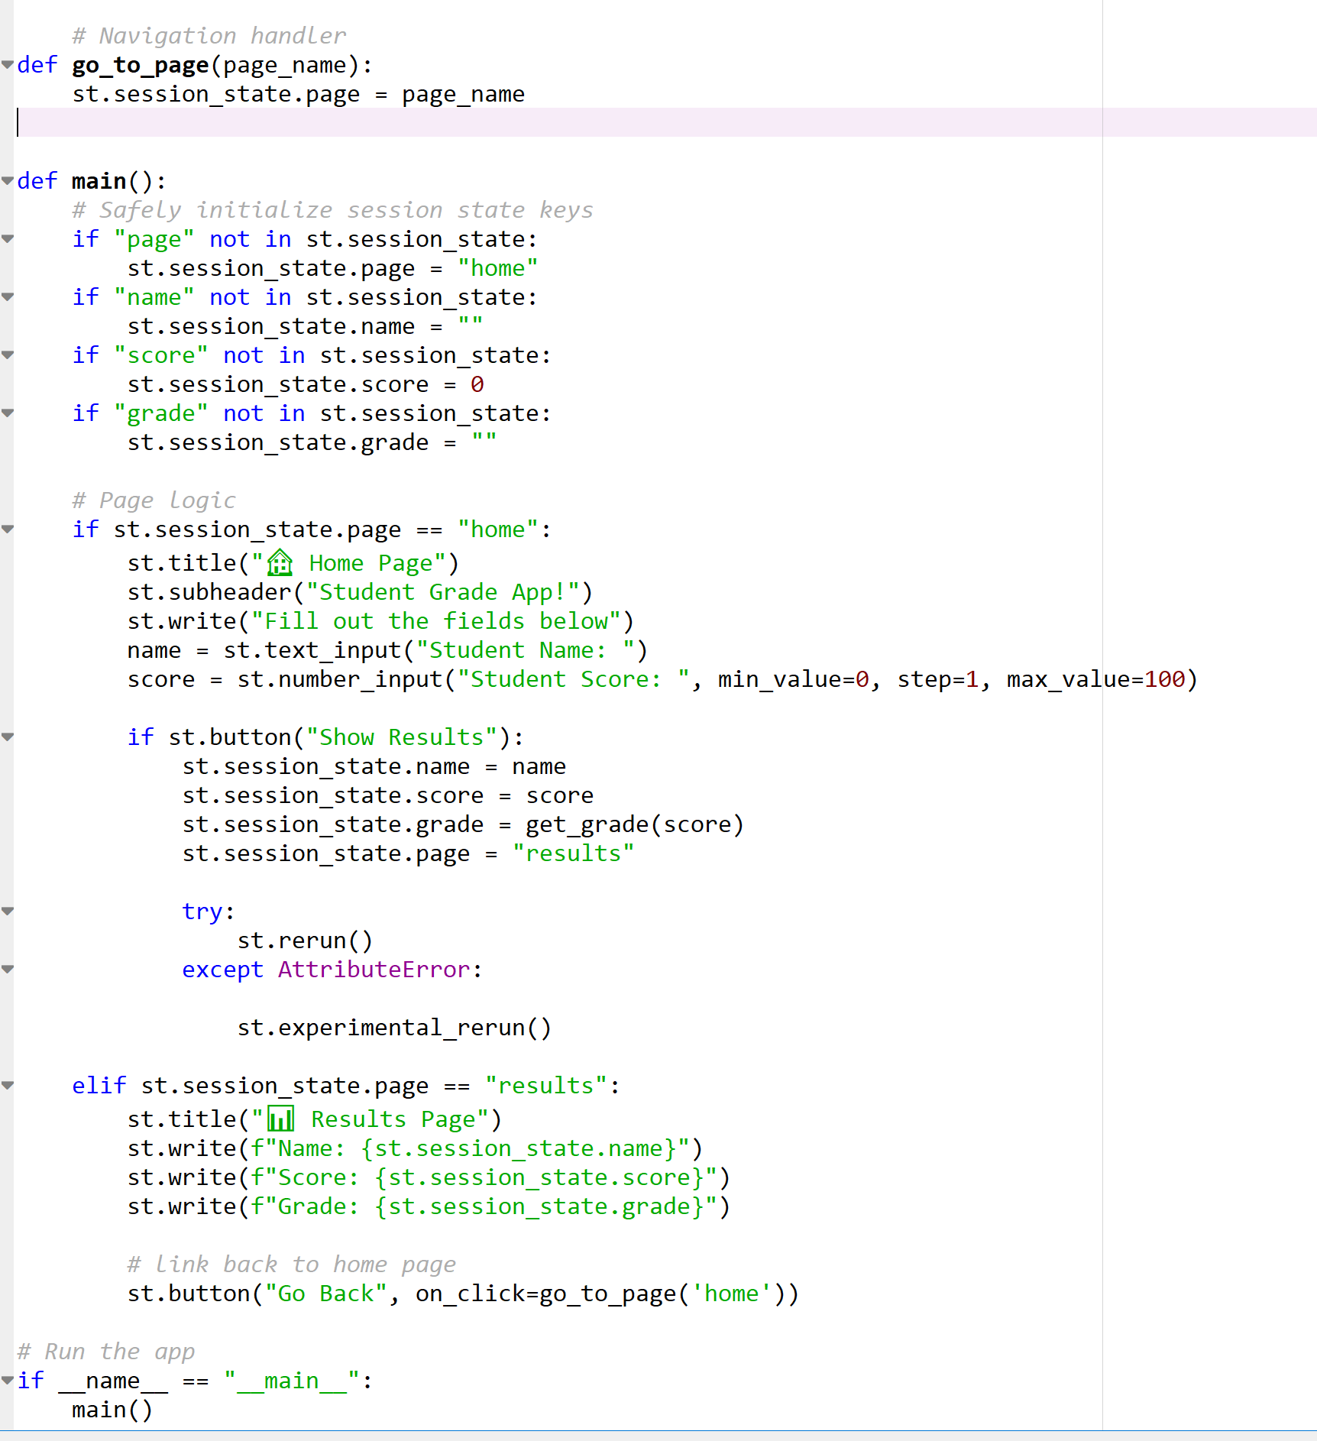
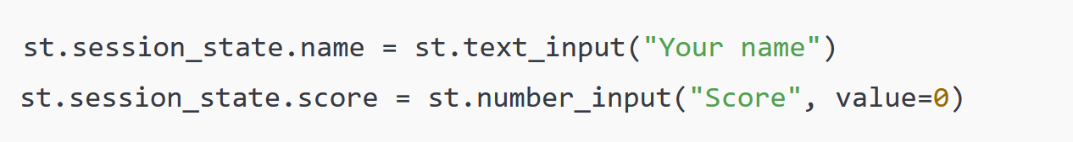
1 Creating a multipage streamlit app, not using sidebar continued…..
Store User Inputs in st.session_state
3. Store user input in st.session_state
1. st.session_state used to define and set initial values for page and variables
2 .When button clicked, user input captured and st.session_state for variable values changed.
3 . st.experimental_rerun() called for quick navigation between pages.

Slide 5
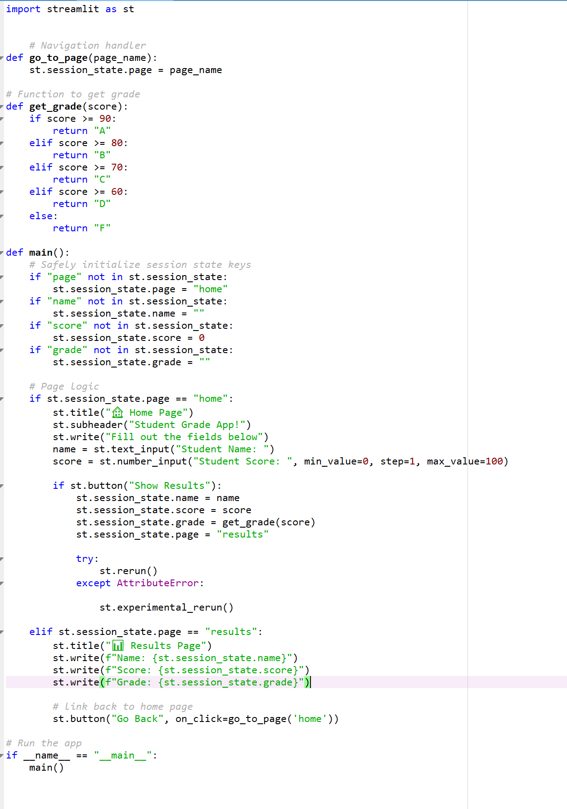
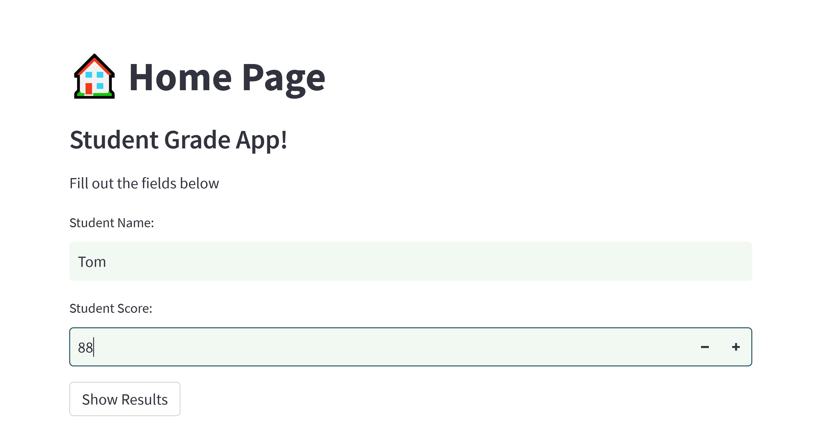

Application and output

Slide 6
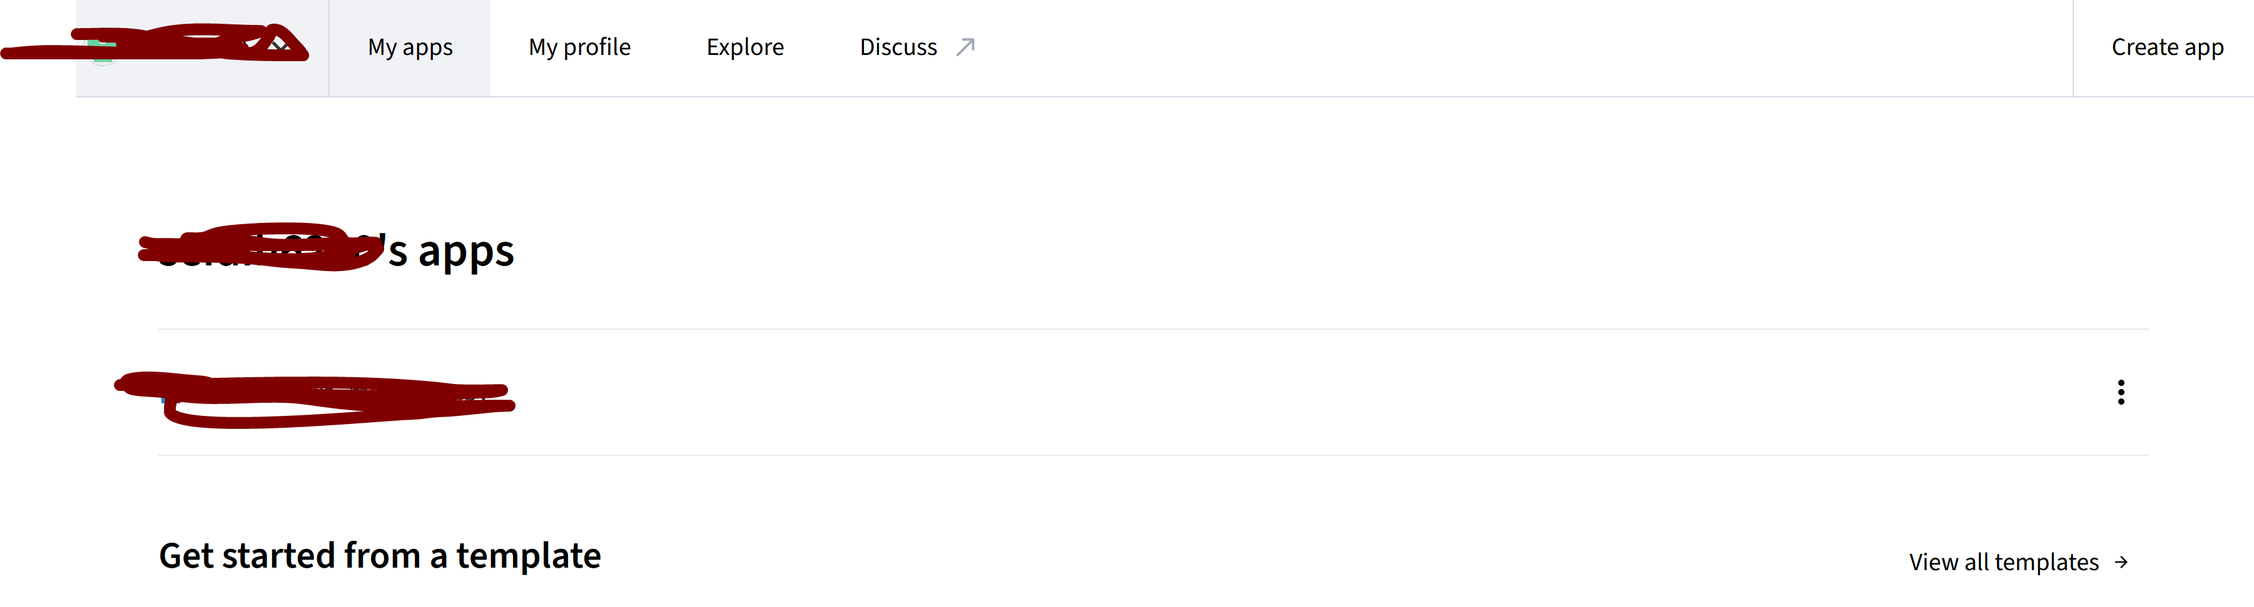
2 Sharing streamlit app (using Streamlit Community Cloud and GitHub)
One approach to consider when wanting to share a streamlit app WITHOUT creating an exe is by using Streamlit Community Cloud.
Advantages of this approach is that the app can run on any platform, it can also be made private.
Upload the streamlit code (python file(s)) AND “requirements.txt” to github. (App MUST be public at this point)
Go to Streamlit Community Cloud , Click the “Create app” button. See below

Slide 7
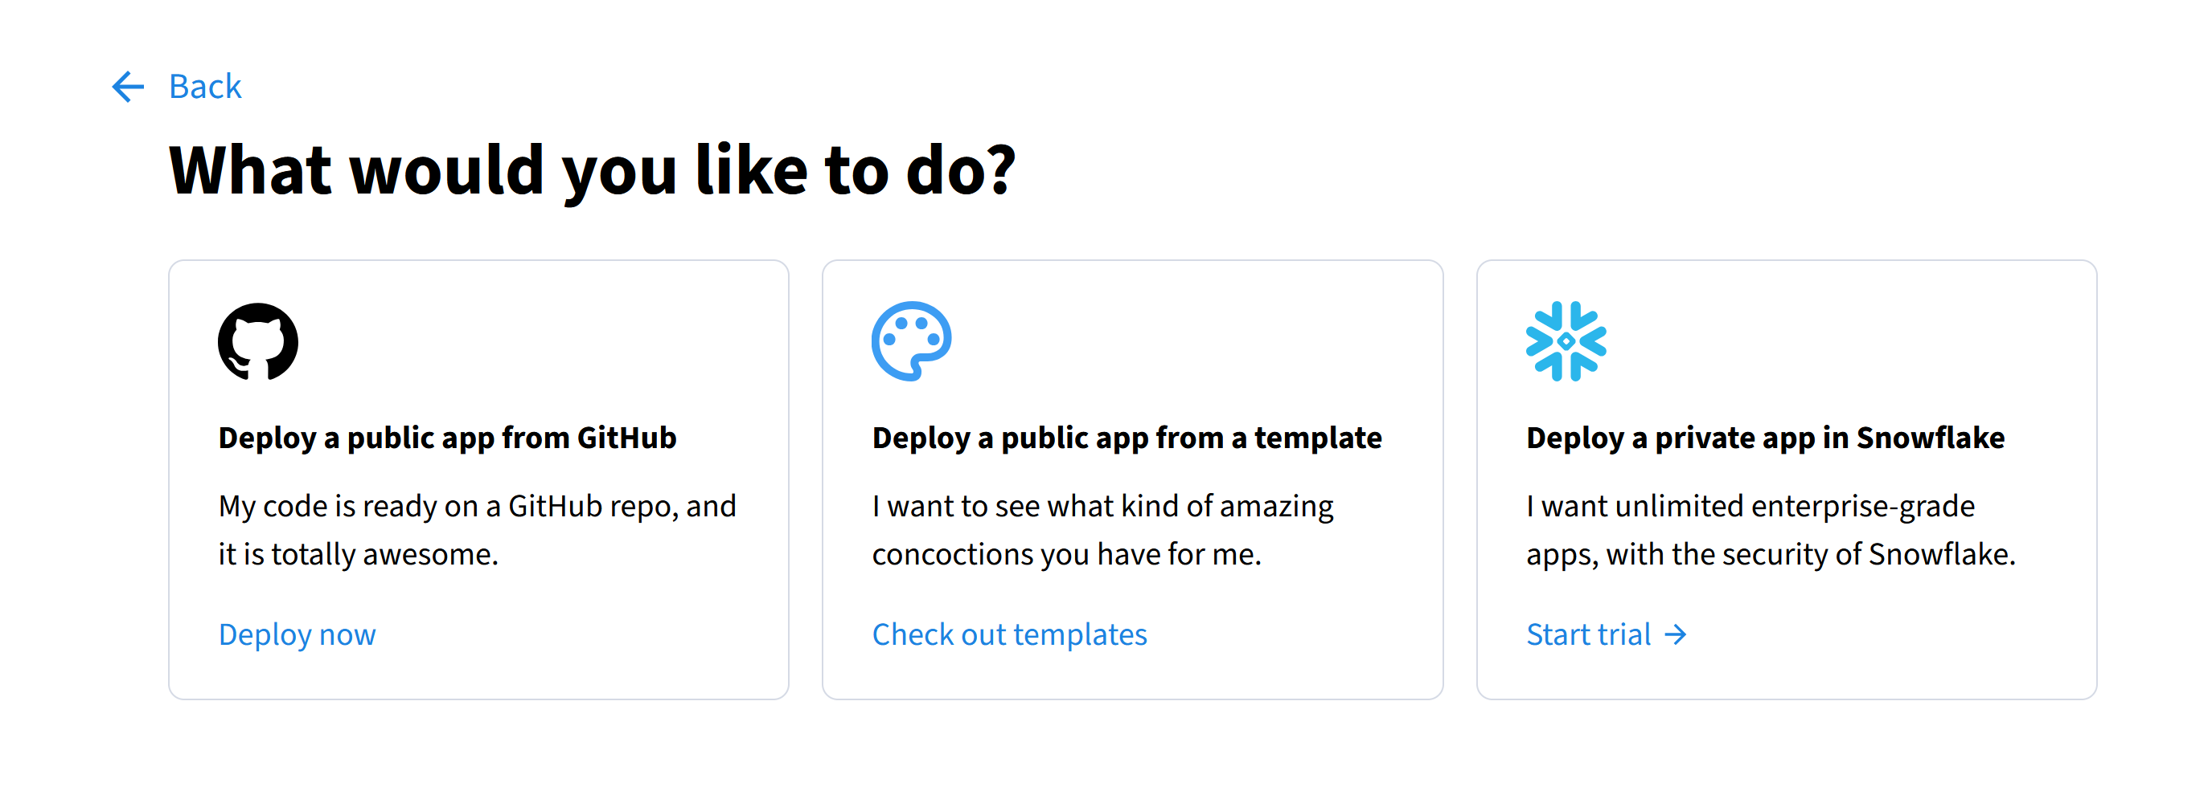
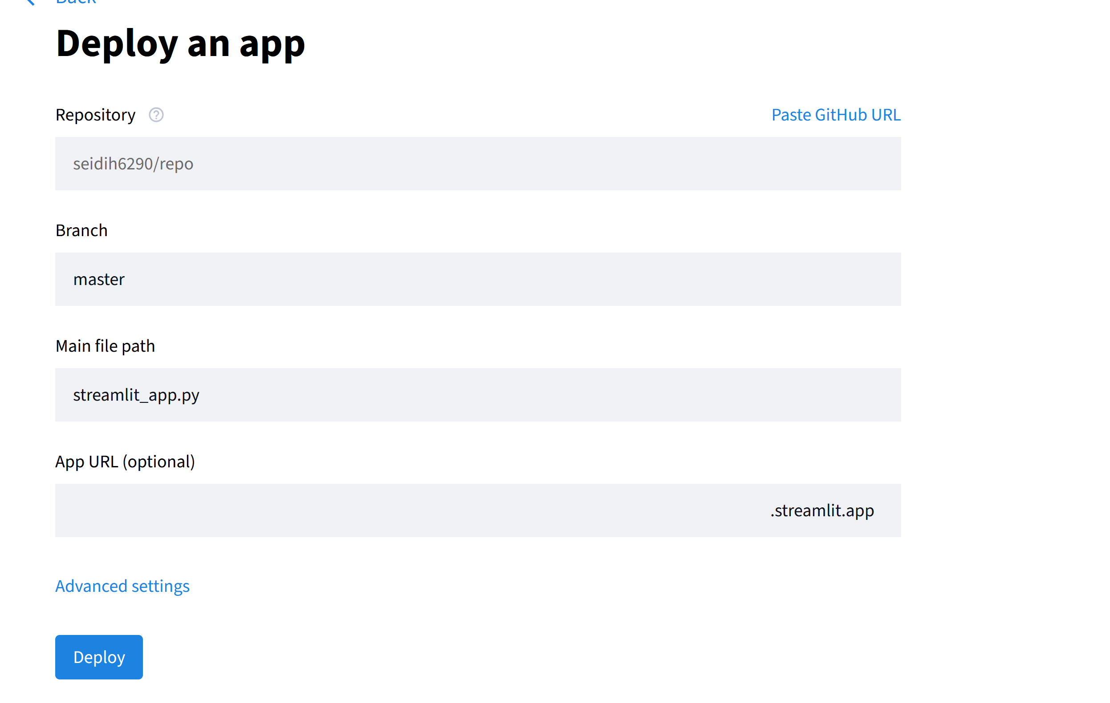
2 Sharing streamlit app (using Streamlit Community Cloud and GitHub) continued…
3. Select Deploy a public app from GitHub.
4. Select GitHub repository , make sure main python file is selected in the “Main file Path” field then click the “Deploy” button
Once button is clicked , the app will be created and displayed, see next slide

Slide 8
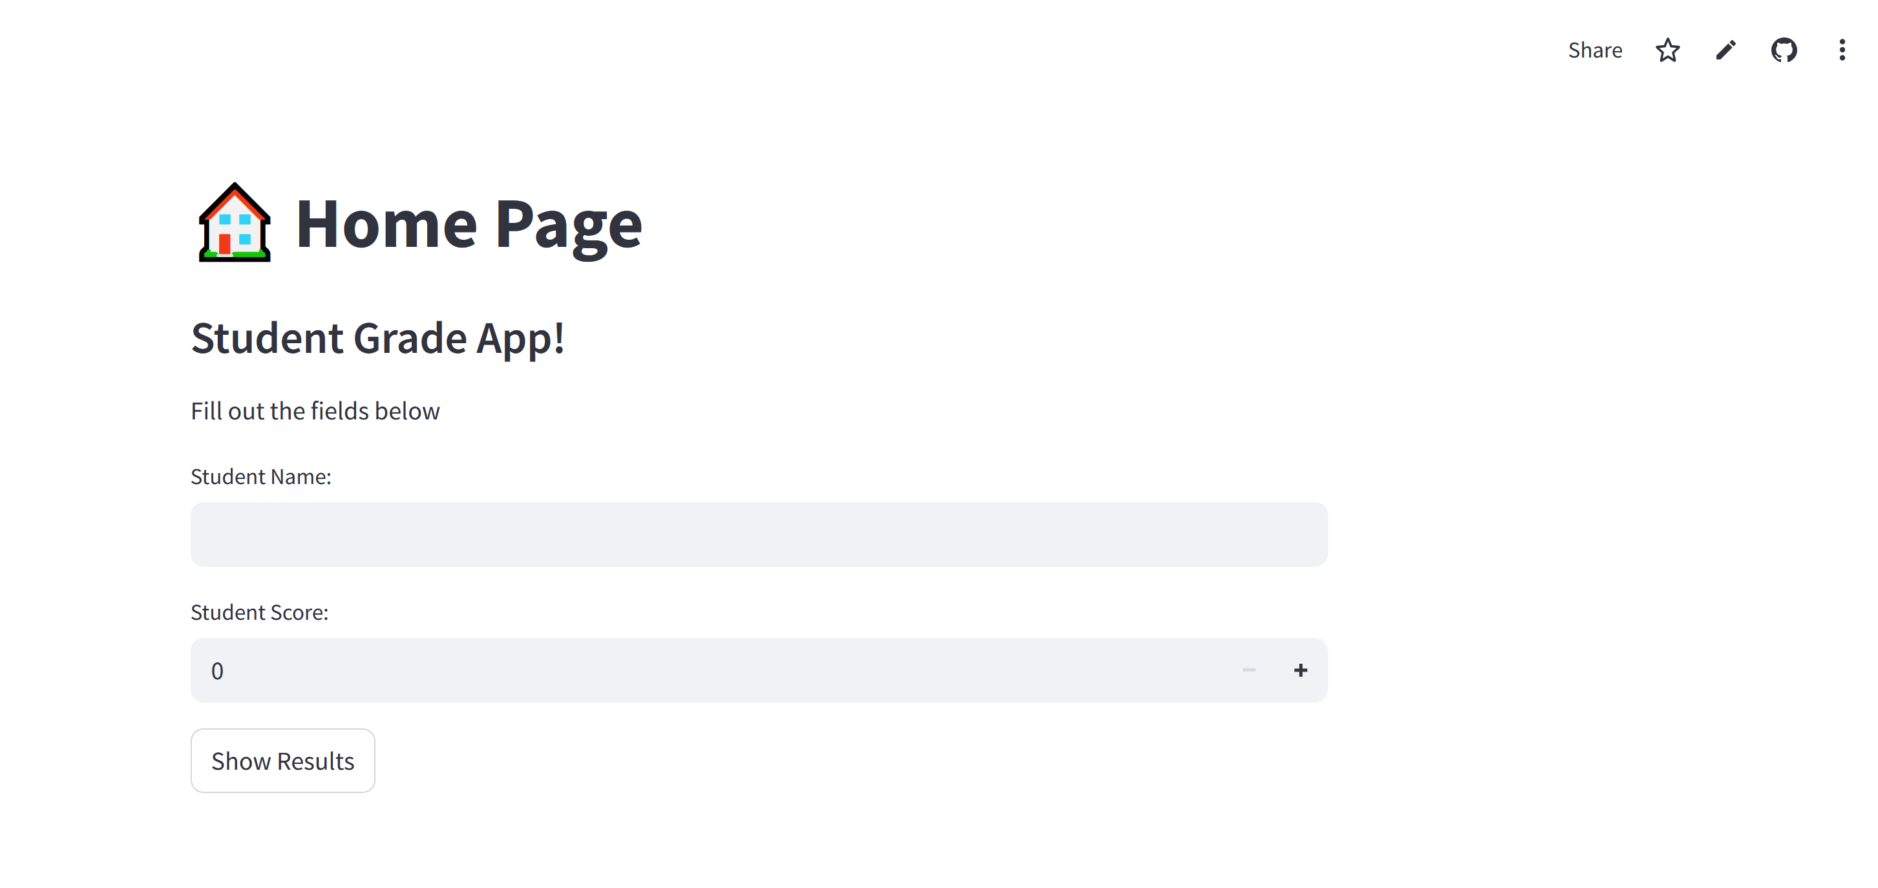
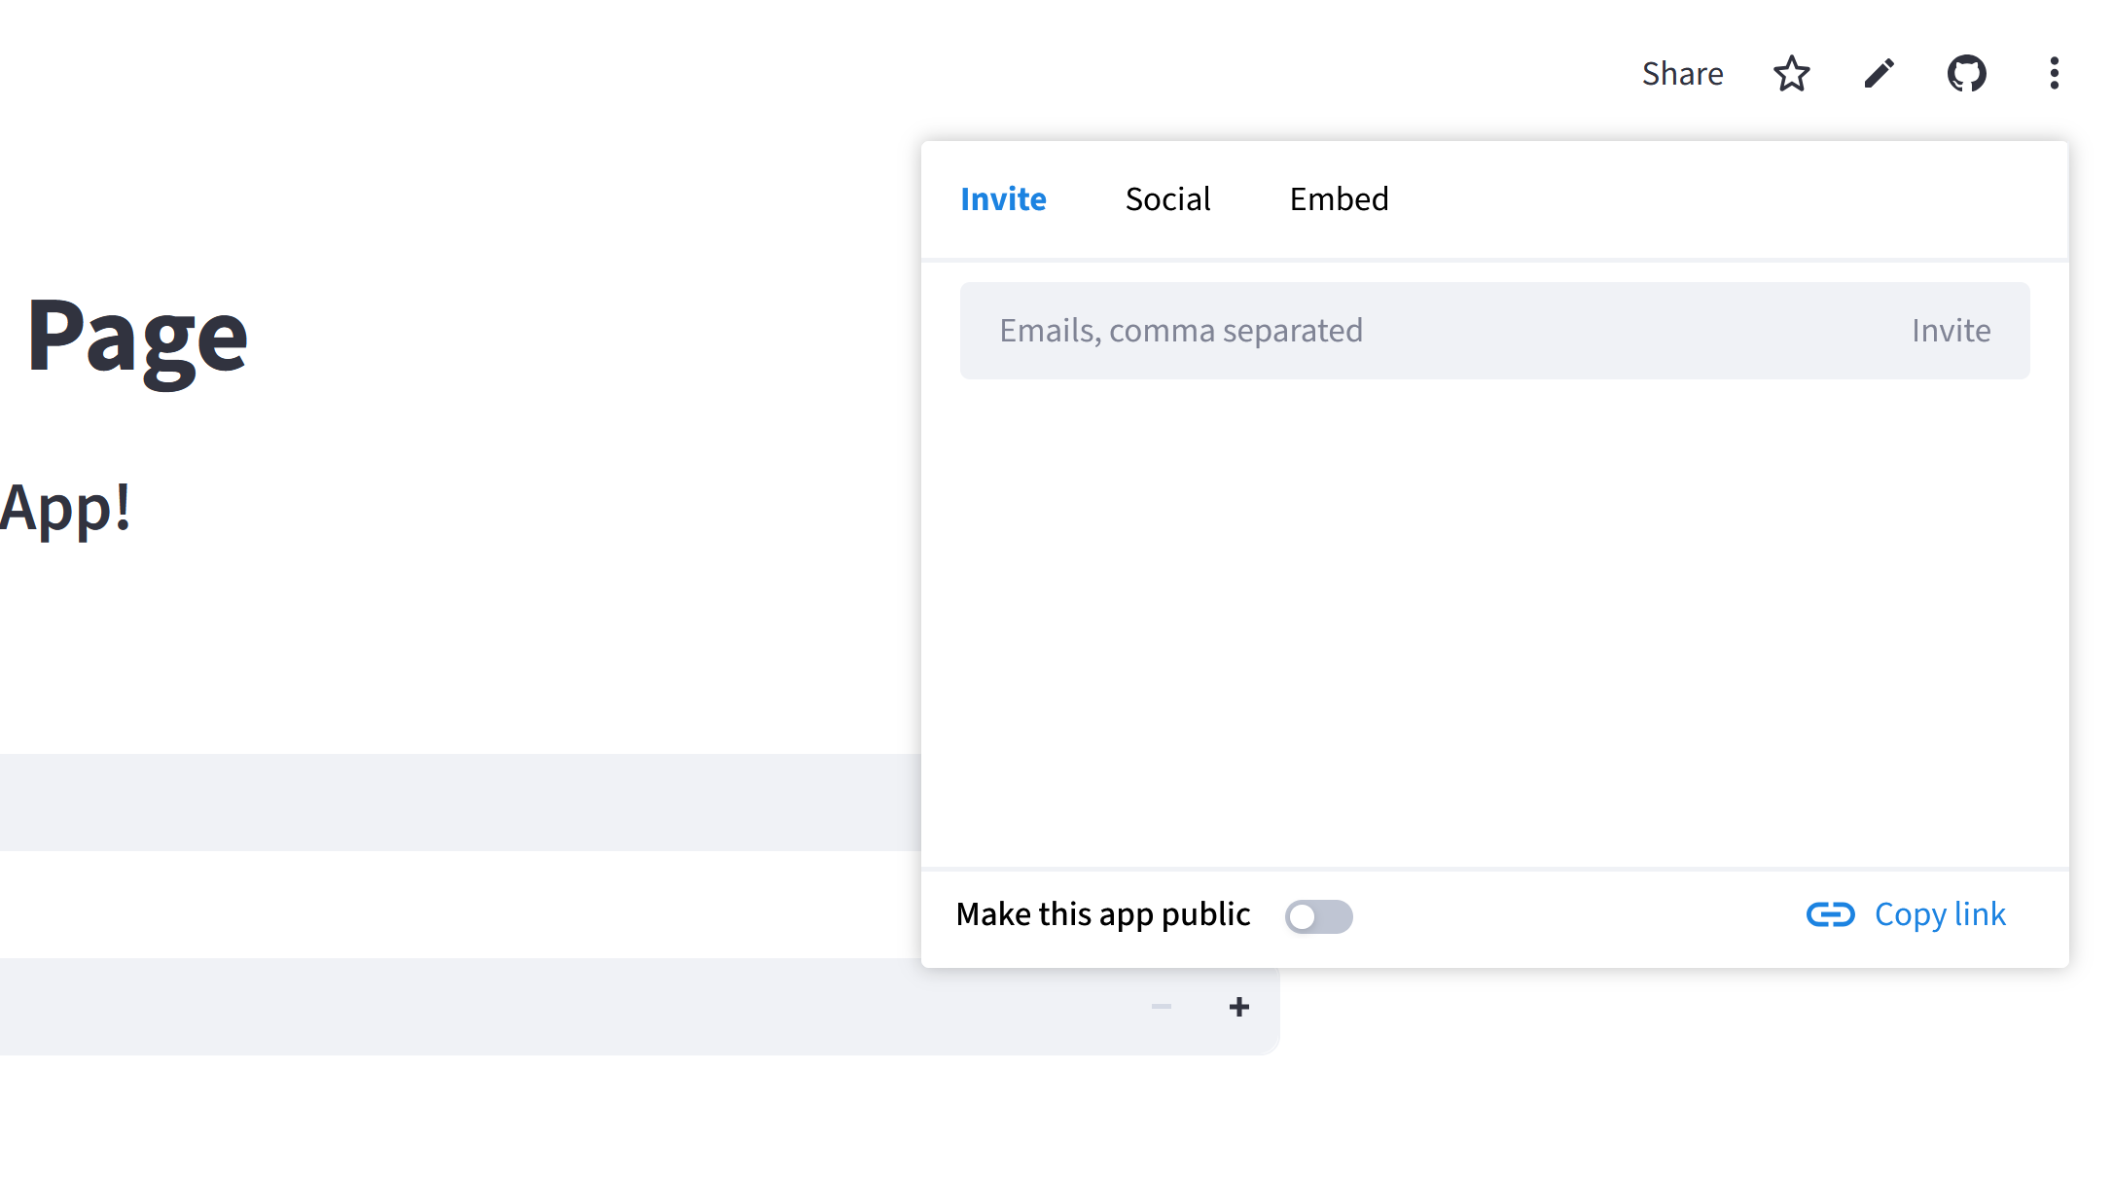
2 Sharing streamlit app (using Streamlit Community Cloud and GitHub) continued…
5. To share, click the “Share” link.
6. Make private by unselecting the “Make this app public” option. Add email of person to share with and click the “Invite” button.

Slide 9
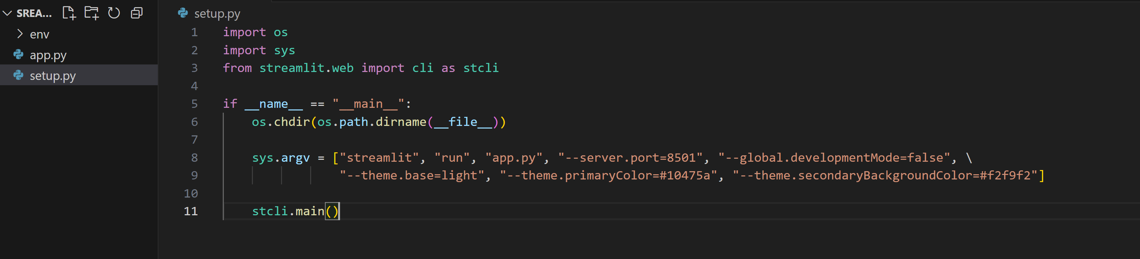
3. Converting Streamlit App to EXE file (Console based)
1. Create a Startup Python File
Becauase Streamlit apps are server-based and you launch them with streamlit run app.py. We need to create a startup Python script (e.g., start.py) that will handle running your Streamlit app when the executable is launched.
2. The startup file should be added in the root folder (same place main python file is located). See image of start file created for “app.py” below

Slide 10
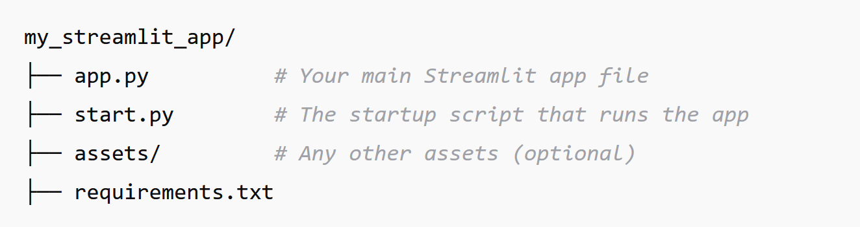
3. Converting Streamlit App to EXE file (Console based) continued…
Make sure the file structure is similar to what is shown below
The virtual environment should have been created prior to adding the start up file. Pip installs must have also been done for all required libraries
3. Pip install auto-py-to-exe .

Slide 11
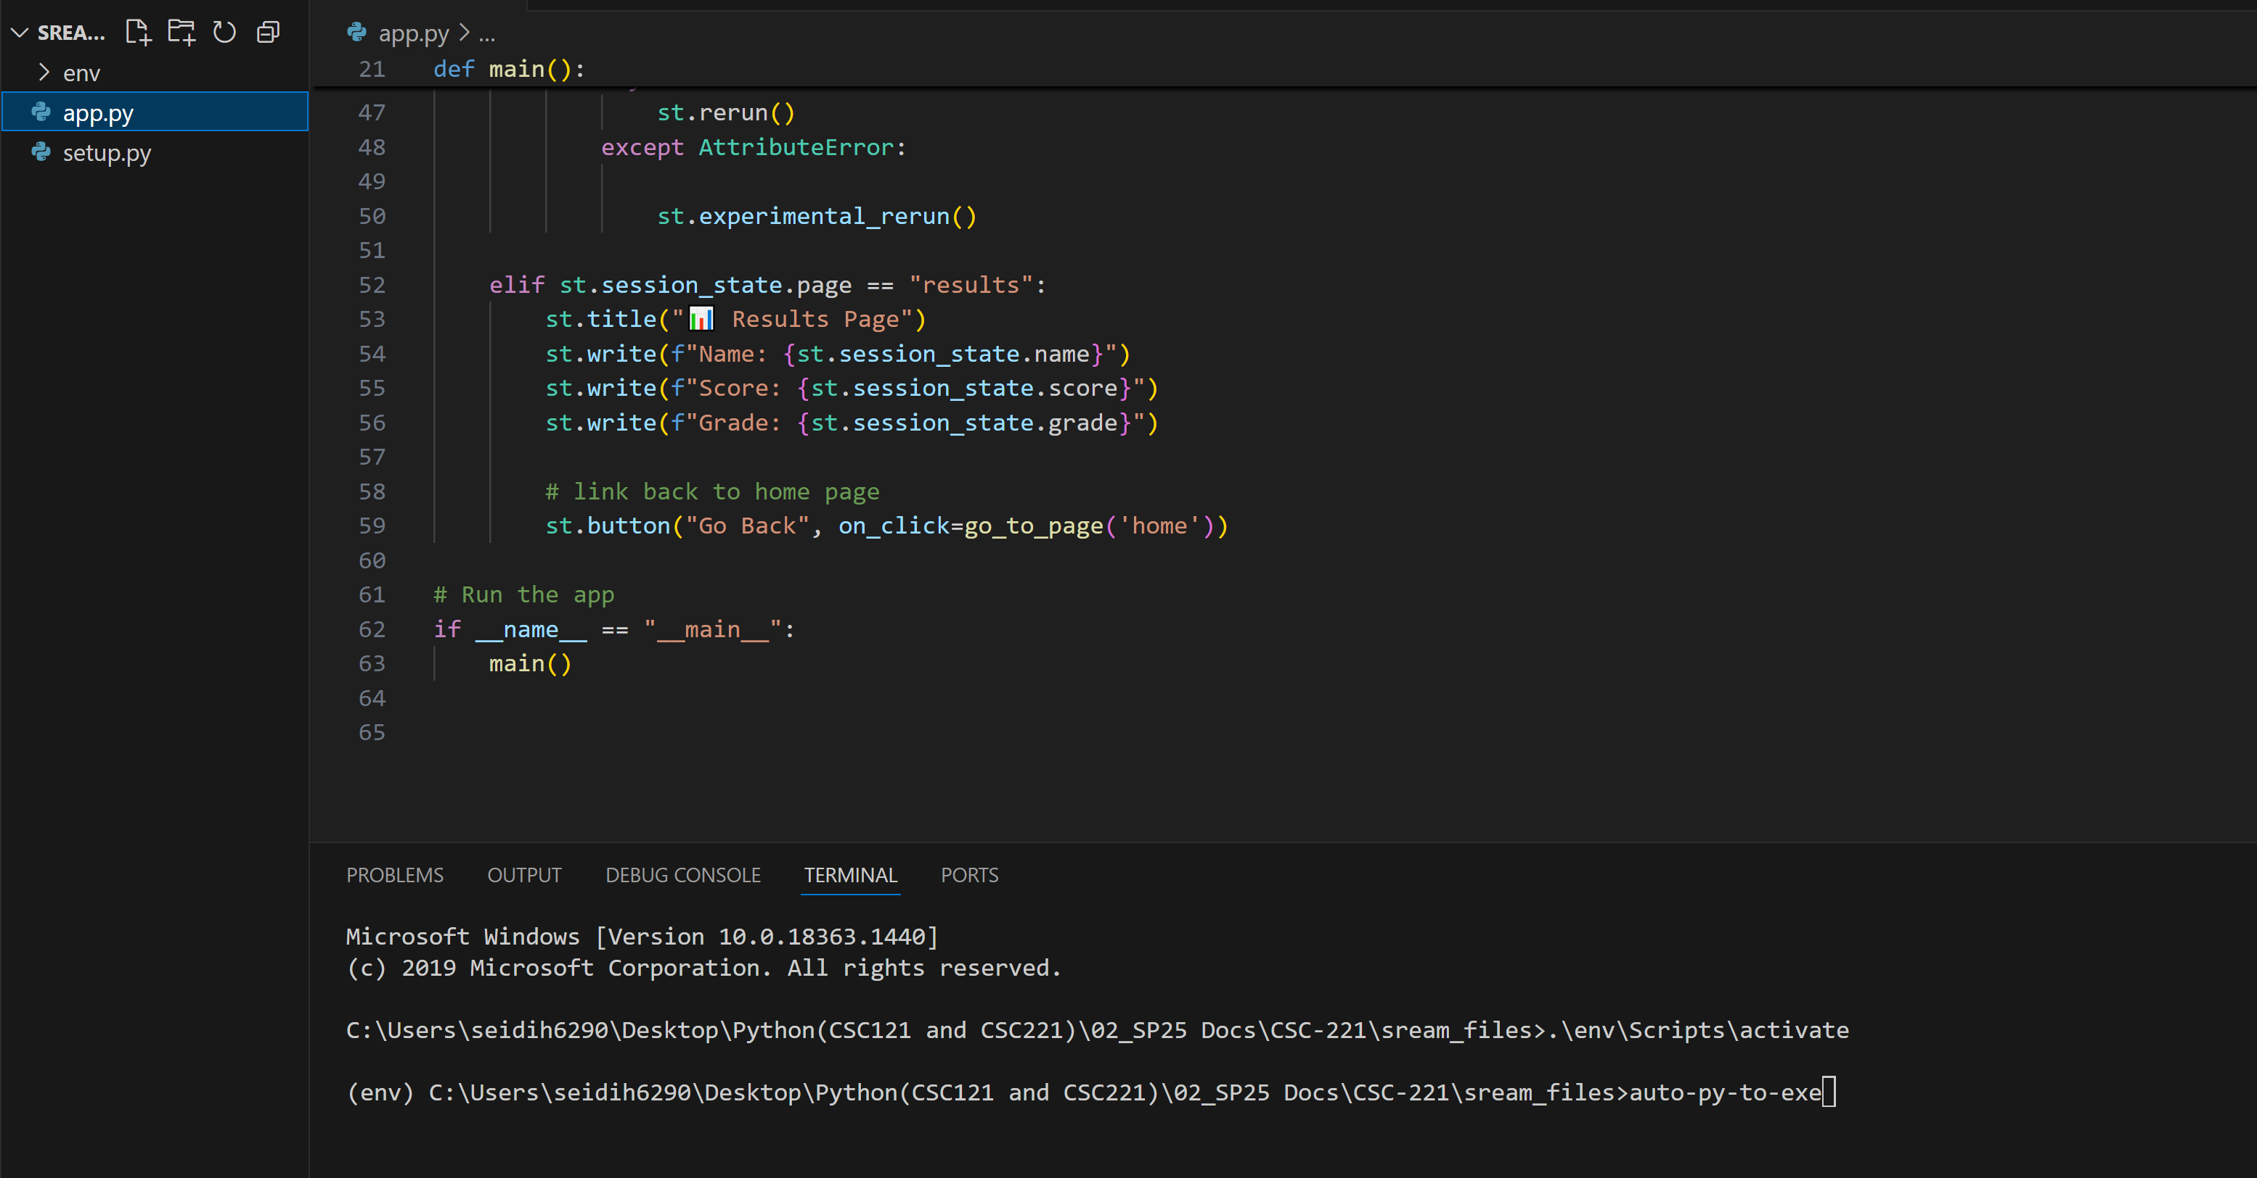
3. Converting Streamlit App to EXE file (Console based) continued…
4. Run auto-py-to-exe, see below.

Slide 12
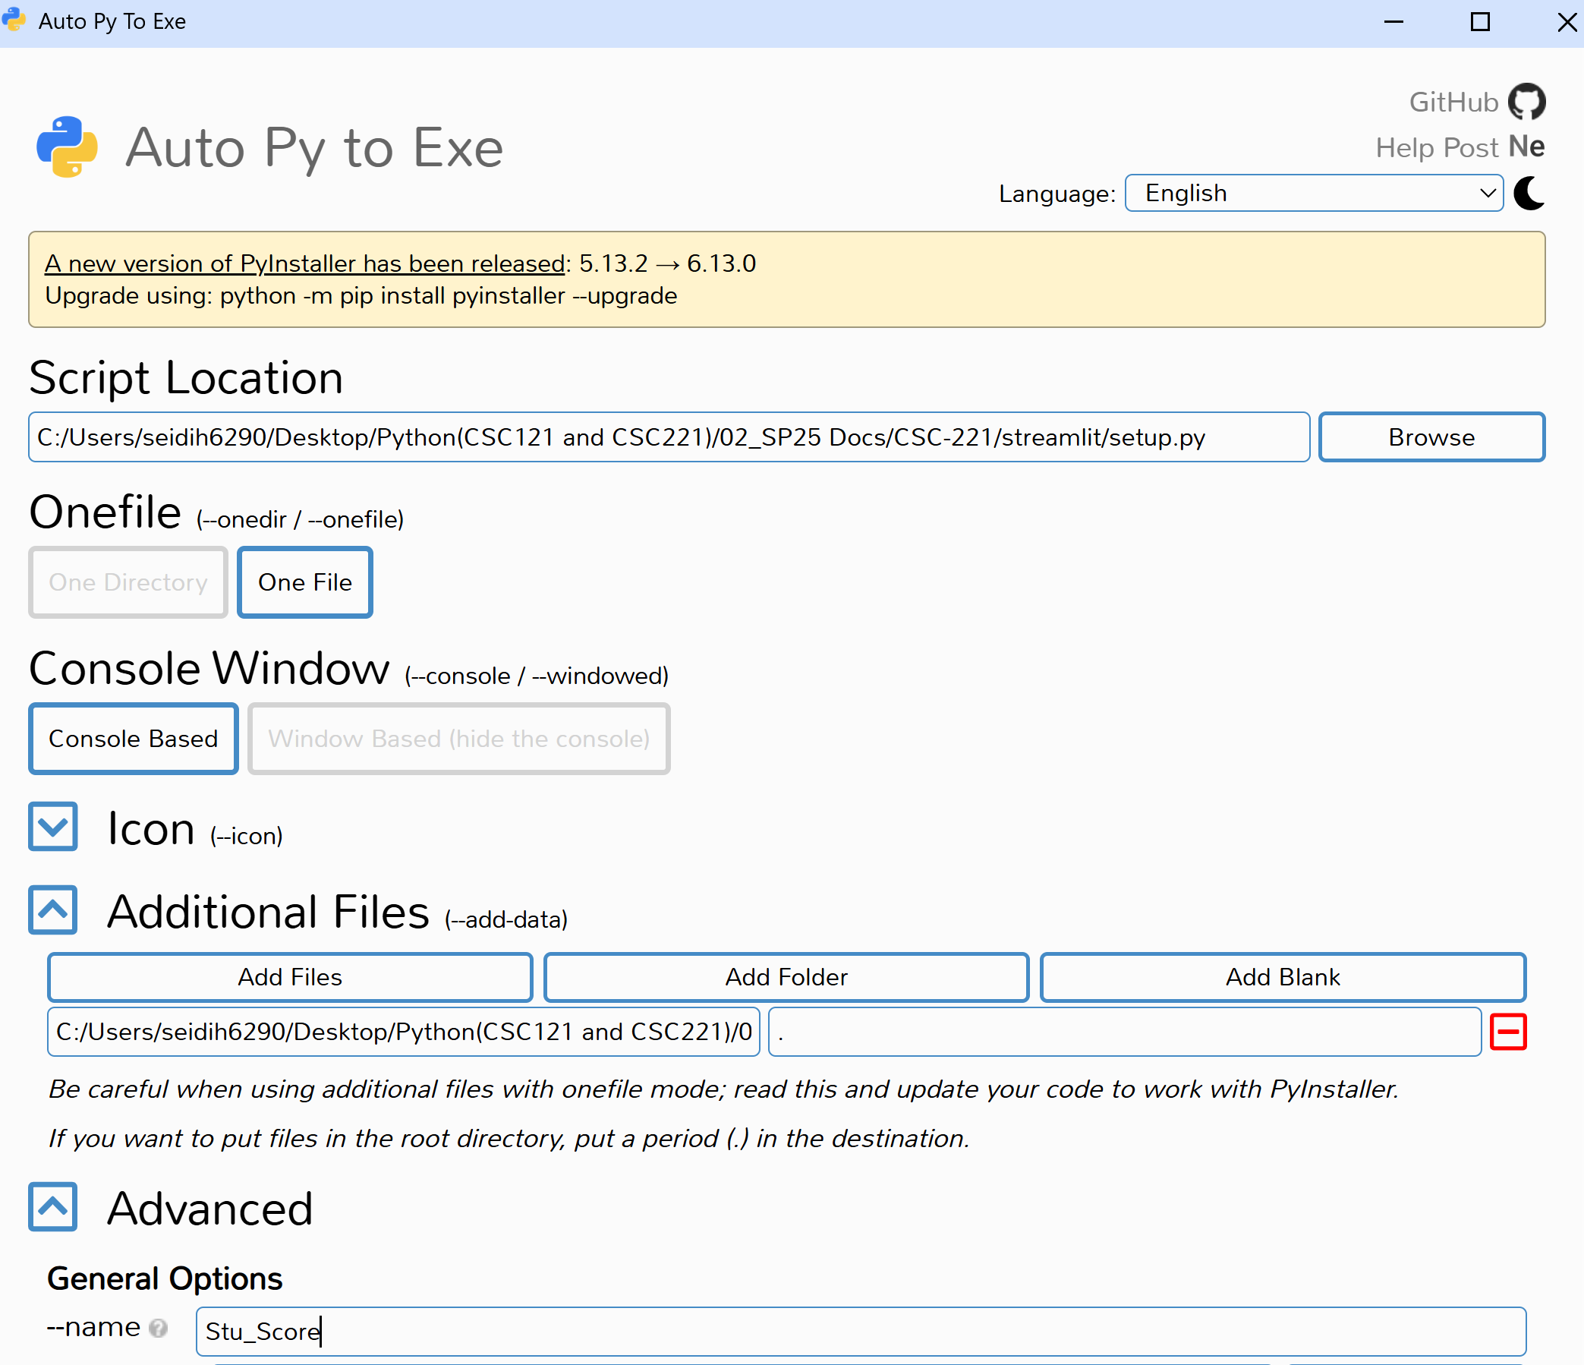
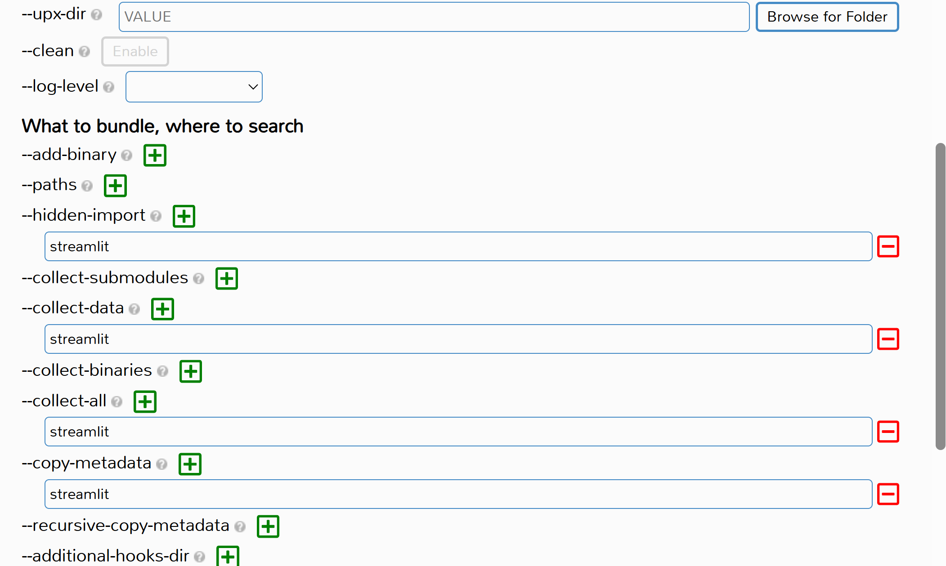
3. Converting Streamlit App to EXE file (Console based) continued…
5. The “Auto Py to Exe “ window will open. Make sure fields are filled as per instructions below
Under Script Location, select the location of the startup file. In the program we are working with , it’s “setup.py”
Under Onefile select One file.
Select Console Based under Console Window. This is a good starting point because errors will be displayed in the console window , making it easier to debug if errors were to occur.
If you wish to assign an .ico image to the .exe file, specify the path under Icon.
Under Additional Files add the folder that references the main code file. If the file is not in a folder, select add the file. In our case here, the main file is called app.py
Under Advanced give your .exe file a name.
Include all imported libraries , such as streamlit under hidden-imports, collect-all, and copy-metadata .
Click “CONVERT .PY TO .EXE “ to convert the application

Slide 13

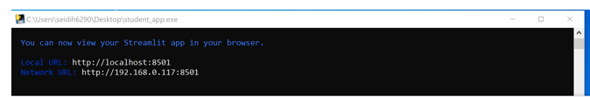
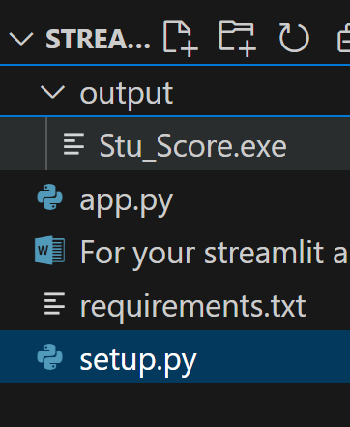
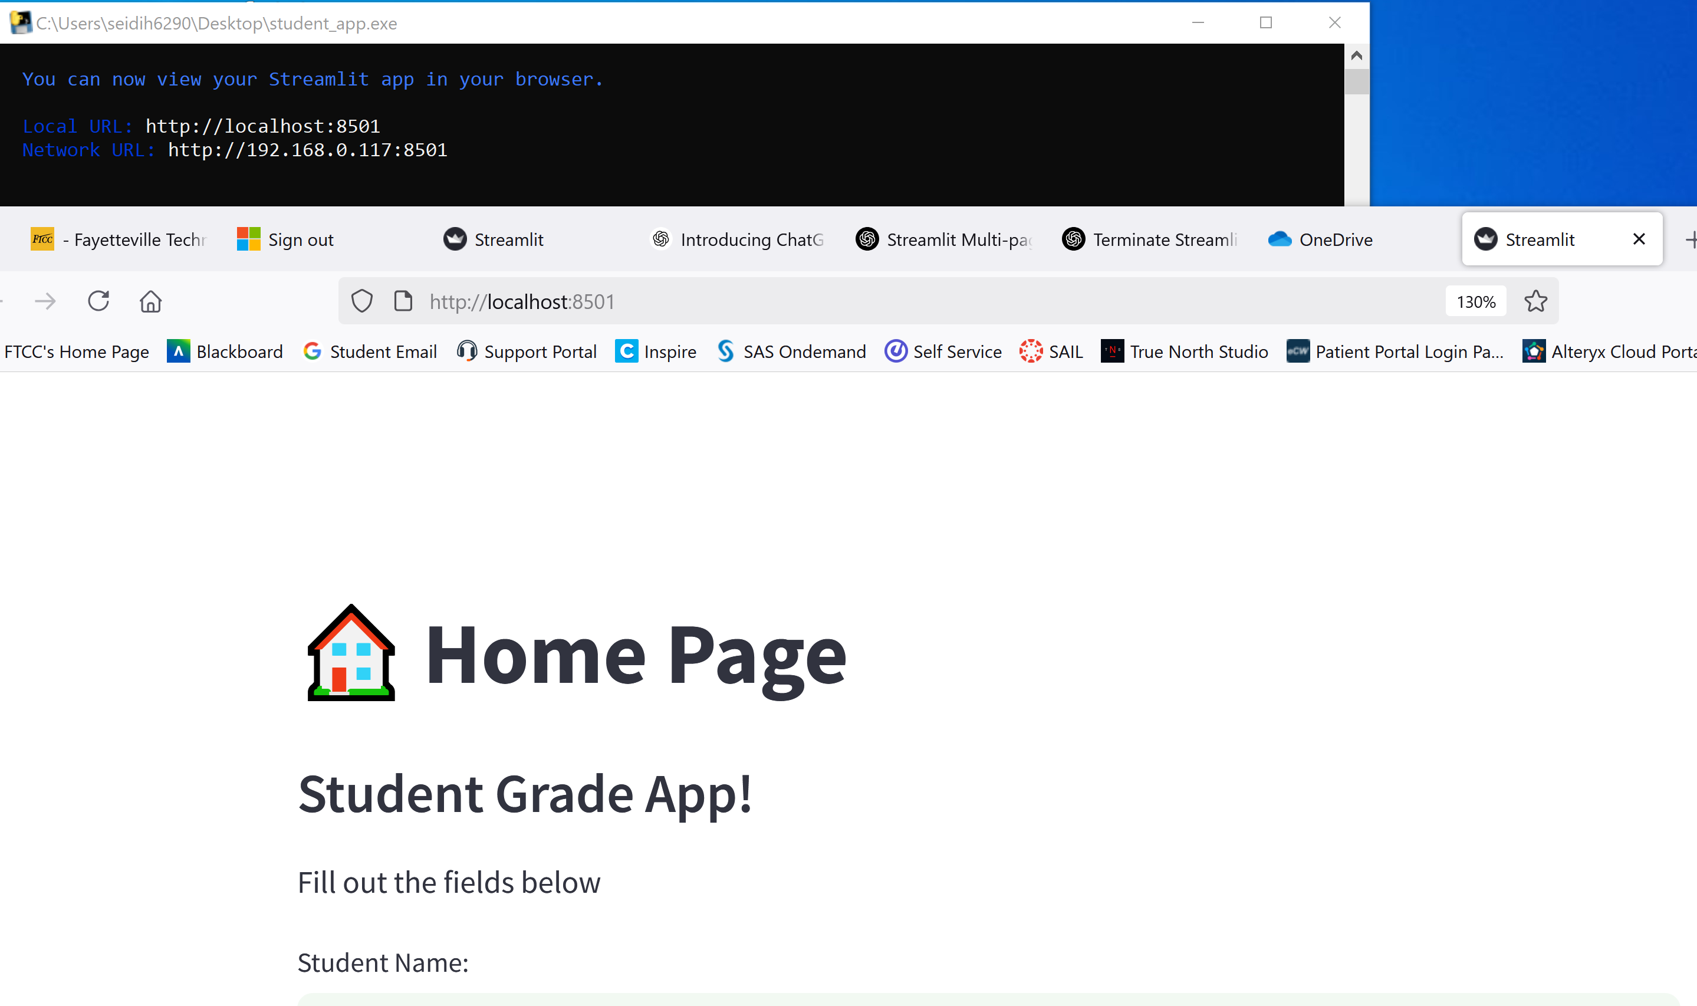
3. Converting Streamlit App to EXE file (Console based) continued…
6. The .exe file will be created and added under a folder named “output”.
7. Double-click on app to open. Console window opens and launches app in browser
8. CLOSE the console to PROPERLY close app.
You MUST close the Console window or else app will continue to run in the background.

Slide 14
4. Converting Streamlit App to EXE file (Window Based)
IMPORTANT thing to remember with a windowed streamlit app , closing the browser tab DOES NOT STOP the app.
Remember, you had to close the console with a console-based app.
To create a Window-Based app and configure it to close properly , refer to following instructions:
Add script to properly close app. We will consider an “Exit” button.
Use auto-py-to-exe to convert the app to a window-based exe.
See next slide

Slide 15
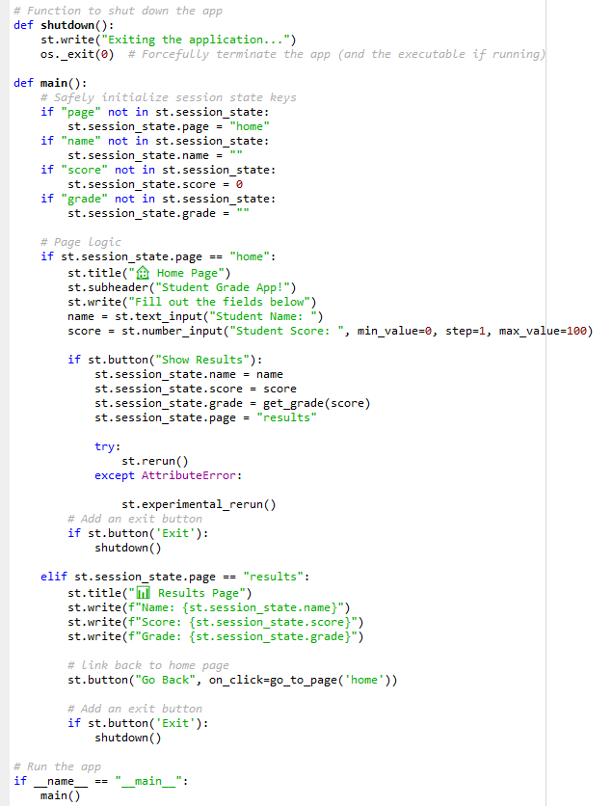
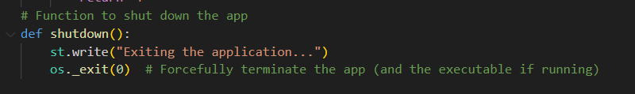
4. Converting Streamlit App to EXE file (Window Based)continued…
Add script to properly close app. We will consider an “Exit” button.
Add a shutdown function to main app file. See below
Home page
Add “Exit” button to all app pages. When clicked , the shutdown() function is called.
Results page

Slide 16
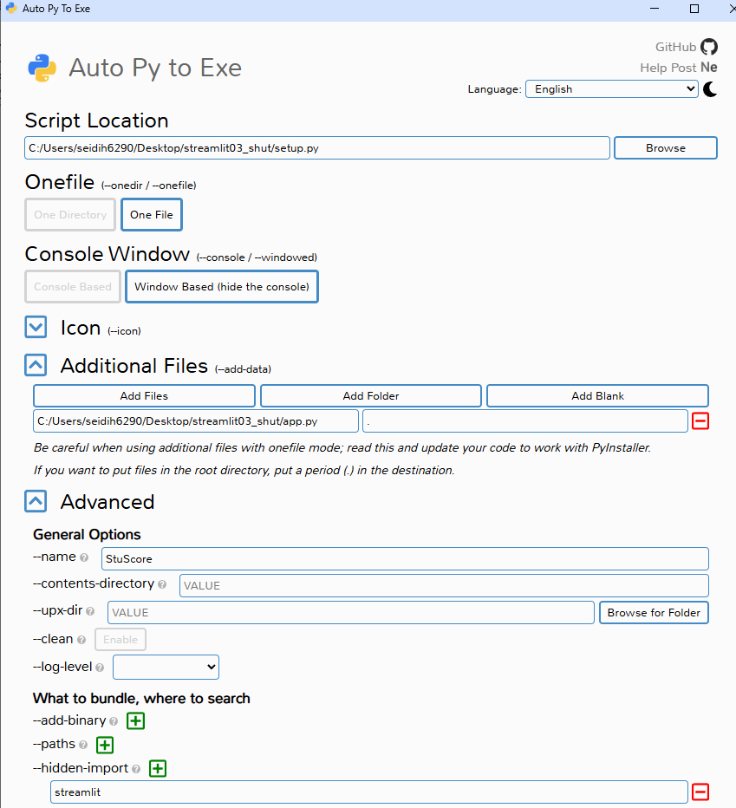
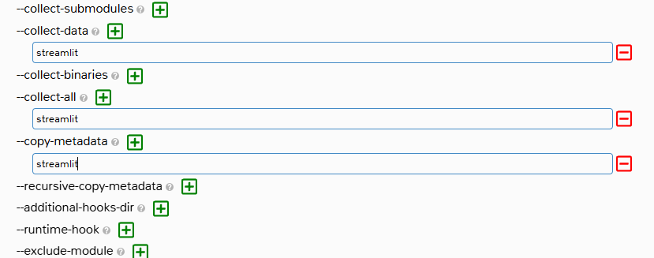
4. Converting Streamlit App to EXE file (Window Based)continued…
2. Use auto-py-to-exe to convert the app to a window-based exe.
Run auto-py-to-exe.
Select same options selected when creating Console-Based only here, select “Window Based (hide the console)” instead. See image on right
After Clicking the “CONVERT .PY TO .EXE “ , an exe file will be created under a folder named “output”

Slide 17
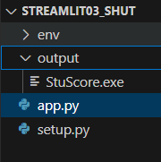
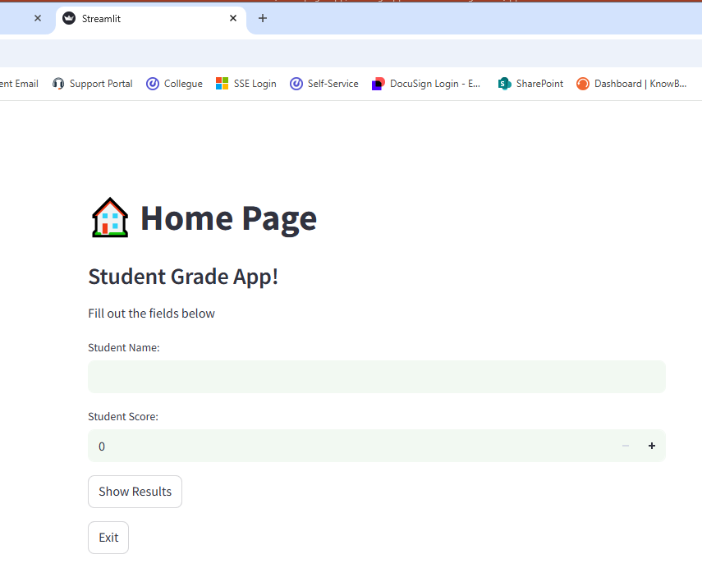
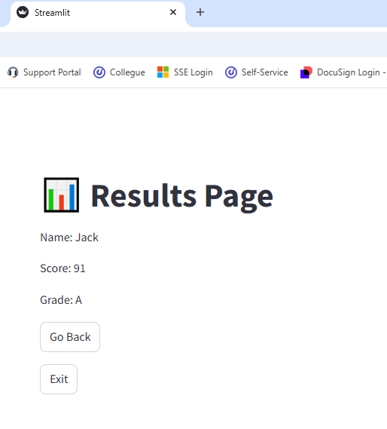
4. Converting Streamlit App to EXE file (Window Based)continued…
When double-clicking the exe, app opens in browser.
If app is NOT properly closed using the “Exit” button, browser tab will NOT open
If Exit button NOT used to close app. The app will continue to run in the background.

Slide 18
Resources
https://ploomber.io/blog/streamlit_exe/

